Slide 1

Problem
min $∥E∥_{F}^{2}+∥r∥_{2}^{2}$
s.t. $\left(A+E\right)x=b+r,$
$x∈F$
$A∈R^{m×n}$: Feature Matrix
$b∈R^{m}$: Label Vector
$E∈R^{m×n}$, $r$: Perturbation
$x∈R^{n}$: Model Coefficient
$x∈F$: Regularization

Slide 2
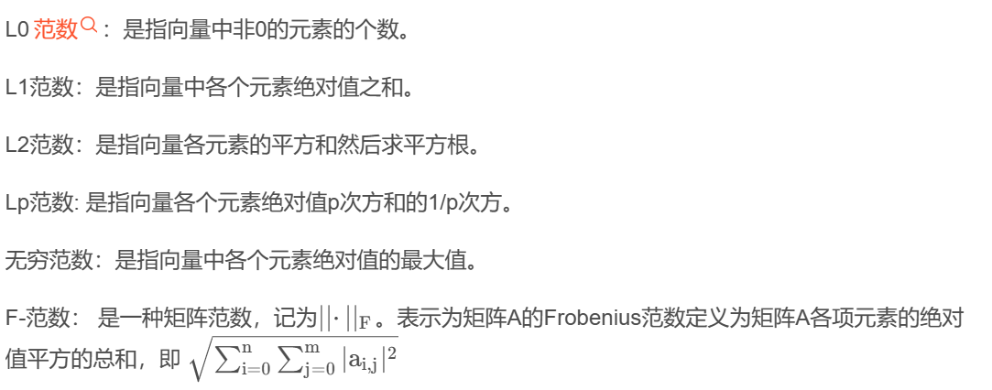
范数：L2范数和矩阵的Frobenius范数（范数是向量空间中一个向量到实数空间中一个实数的映射，而这个映射就是求得一个向量的长度）
矩阵：1-norm：列元素绝对值和的最大值（每个元素的绝对值再相加），列范数
2-norm：A^{T}A的特征值的绝对值得最大值
∞-norm：行范数
费罗贝尼乌斯范数：矩阵的每个元素的绝对值平方之和的1/2次方
矩阵的迹（方阵）：主对角线的元素和
矩阵的谱（方阵）：矩阵特征值的绝对值最大者，称之为矩阵的谱半径

Slide 3
对于有约束的求最值的函数使用梯度导数等方式不适用，但使用拉格朗日对原来的函数变形仍然可以使用导数梯度的方法
对于多个约束条件组成的可行域与f（x）相交的点上的x的，凡是经过该点的函数梯度相加与f（x）一定是方向相反大小相同，λ=0松弛和λ>0紧致，
但是对于非凸问题，拉格朗日函数法找到的极值可能不是最值

Slide 4
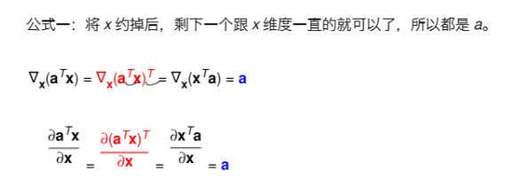
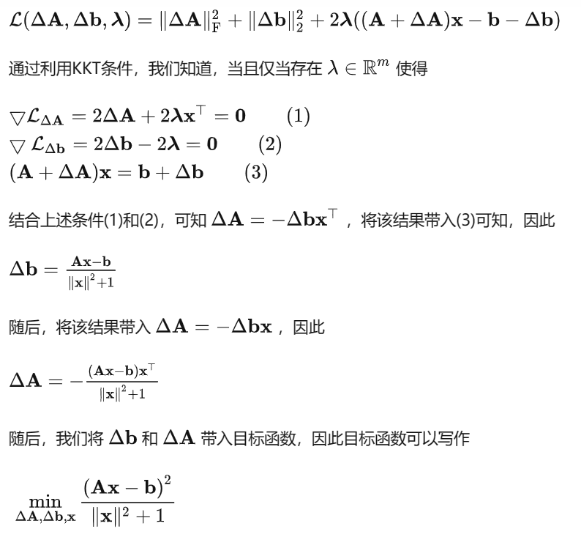
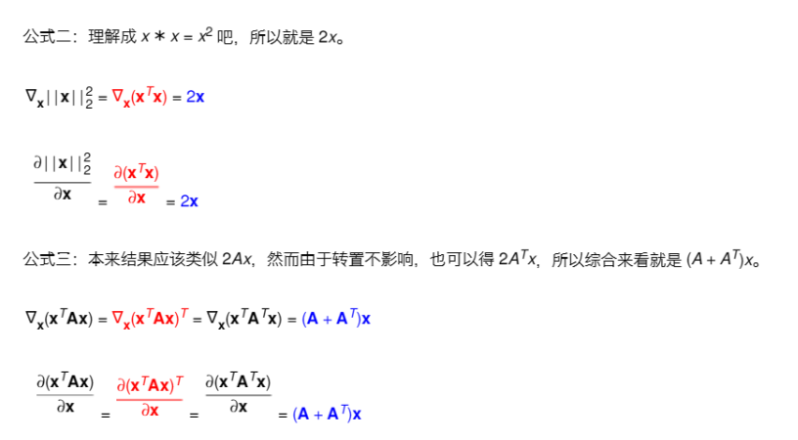
无约束优化问题：直接求导数或者梯度等于0
等式约束优化：使用拉格朗日乘子变换成为无约束优化
等式+不等式约束优化:
将不等式约束转化成等式约束：引入松弛变量/KKT乘子
将等式约束转化成无约束：拉格朗日乘子

Slide 5
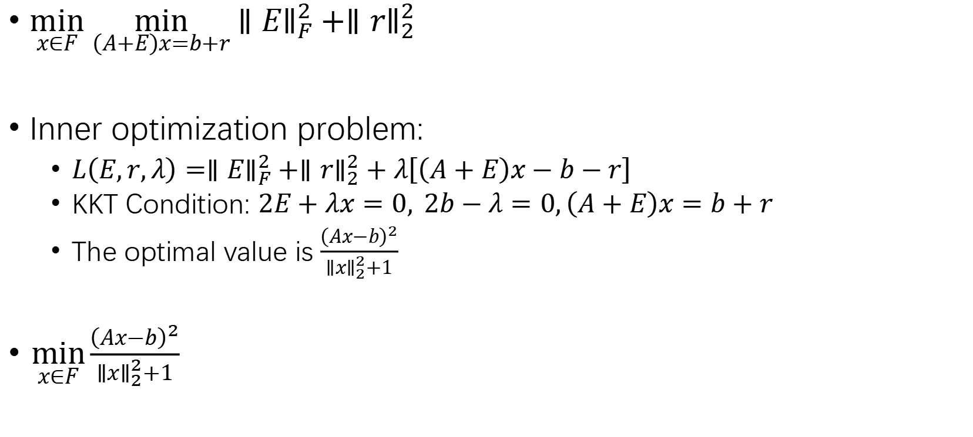
Transformation
$\min_{x∈F}{\min_{\left(A+E\right)x=b+r}∥E∥_{F}^{2}+∥r∥_{2}^{2}}$
Inner optimization problem:
$L\left(E,r,λ\right)=∥E∥_{F}^{2}+∥r∥_{2}^{2}+λ\left[\left(A+E\right)x−b−r\right]$
KKT Condition: $2E+λx=0, 2b−λ=0,\left(A+E\right)x=b+r$
The optimal value is $\frac{{\left(Ax−b\right)}^{2}}{∥x∥_{2}^{2}+1}$
$\min_{x∈F}\frac{{\left(Ax−b\right)}^{2}}{∥x∥_{2}^{2}+1}$

Slide 6
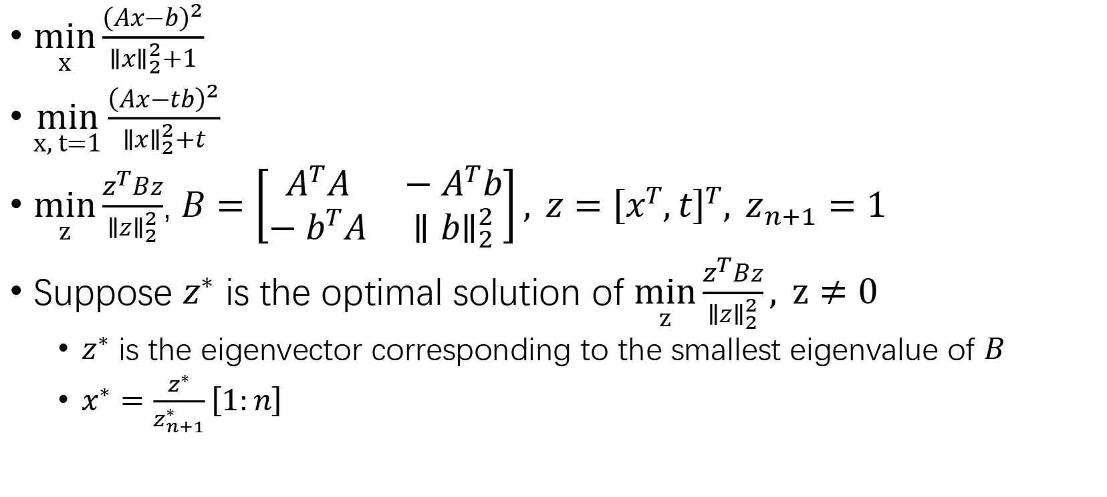
No Regularization
$\min_{x}{\frac{{\left(Ax−b\right)}^{2}}{∥x∥_{2}^{2}+1}}$
$\min_{x, t=1}{\frac{{\left(Ax−tb\right)}^{2}}{∥x∥_{2}^{2}+t}}$
$\min_{z}{\frac{z^{T}Bz}{∥z∥_{2}^{2}}}$, $B=\left[\begin{matrix}A^{T}A & −A^{T}b \\ −b^{T}A & ∥b∥_{2}^{2}\end{matrix}\right], z={\left[x^{T},t\right]}^{T}, z_{n+1}=1$
Suppose $z^{∗}$ is the optimal solution of $\min_{z}{\frac{z^{T}Bz}{∥z∥_{2}^{2}}}, z≠0$
$z^{∗}$ is the eigenvector corresponding to the smallest eigenvalue of $B$
$x^{∗}=\frac{z^{∗}}{z_{n+1}^{∗}}\left[1:n\right]$

Slide 7

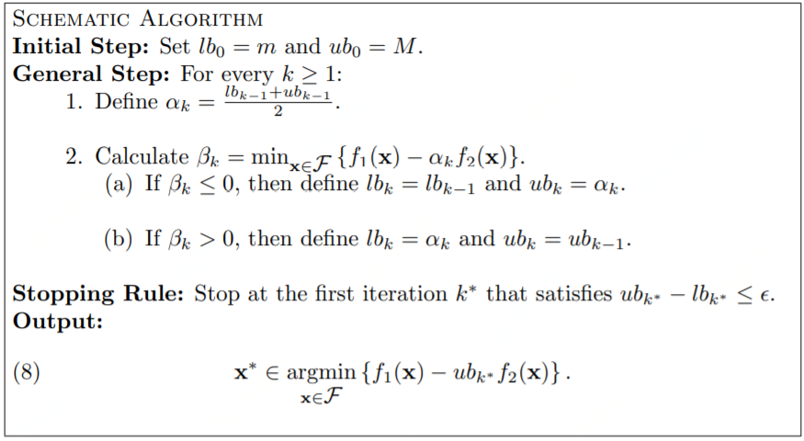
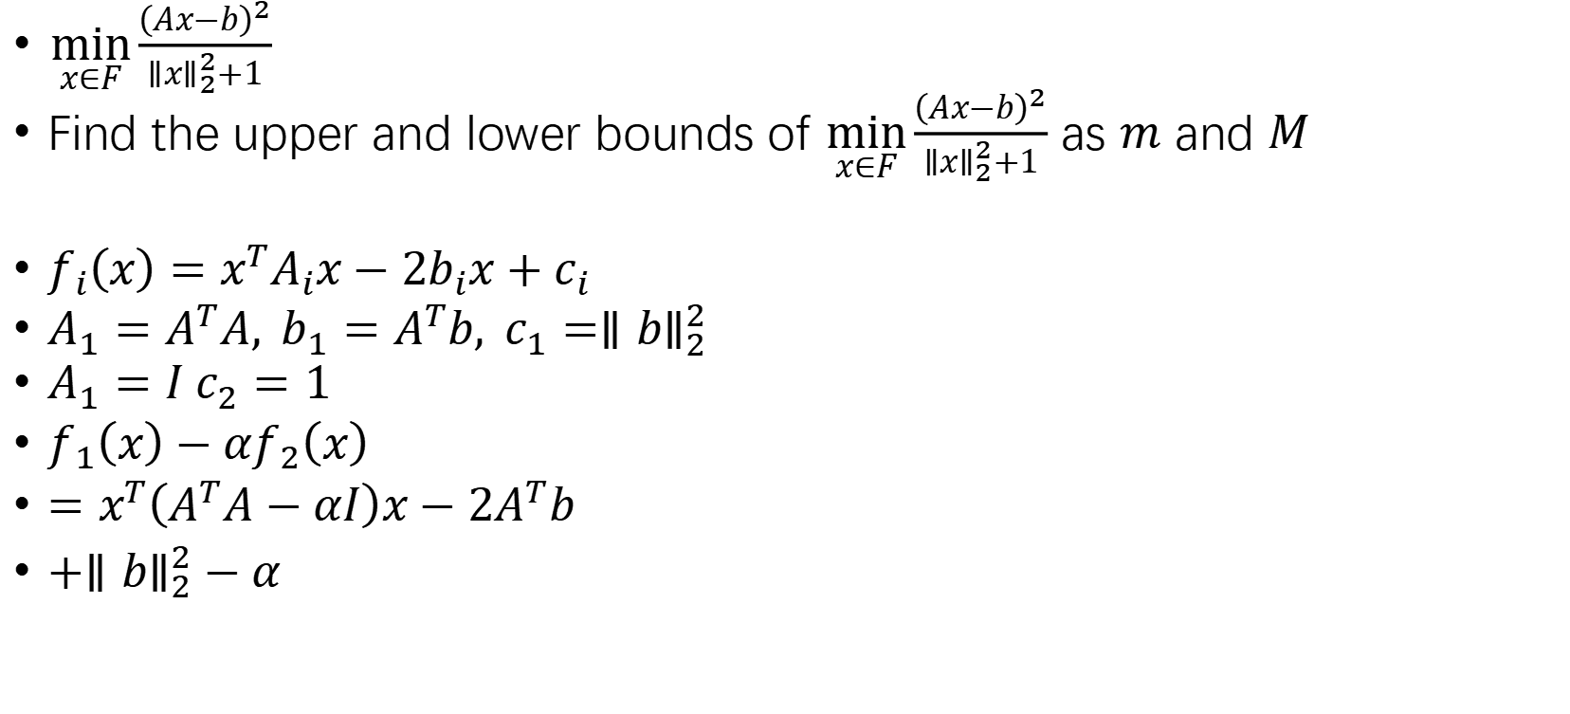
Regularization
$\min_{x∈F}\frac{{\left(Ax−b\right)}^{2}}{∥x∥_{2}^{2}+1}$
Find the upper and lower bounds of $\min_{x∈F}\frac{{\left(Ax−b\right)}^{2}}{∥x∥_{2}^{2}+1}$ as $m$ and $M$
$f_{i}\left(x\right)=x^{T}A_{i}x−2b_{i}x+c_{i}$
$A_{1}=A^{T}A, b_{1}=A^{T}b, c_{1}=∥b∥_{2}^{2}$
$A_{1}=I c_{2}=1$
$f_{1}\left(x\right)−αf_{2}\left(x\right)$
$=x^{T}\left(A^{T}A−αI\right)x−2A^{T}b$
$+∥b∥_{2}^{2}−α$

Slide 8
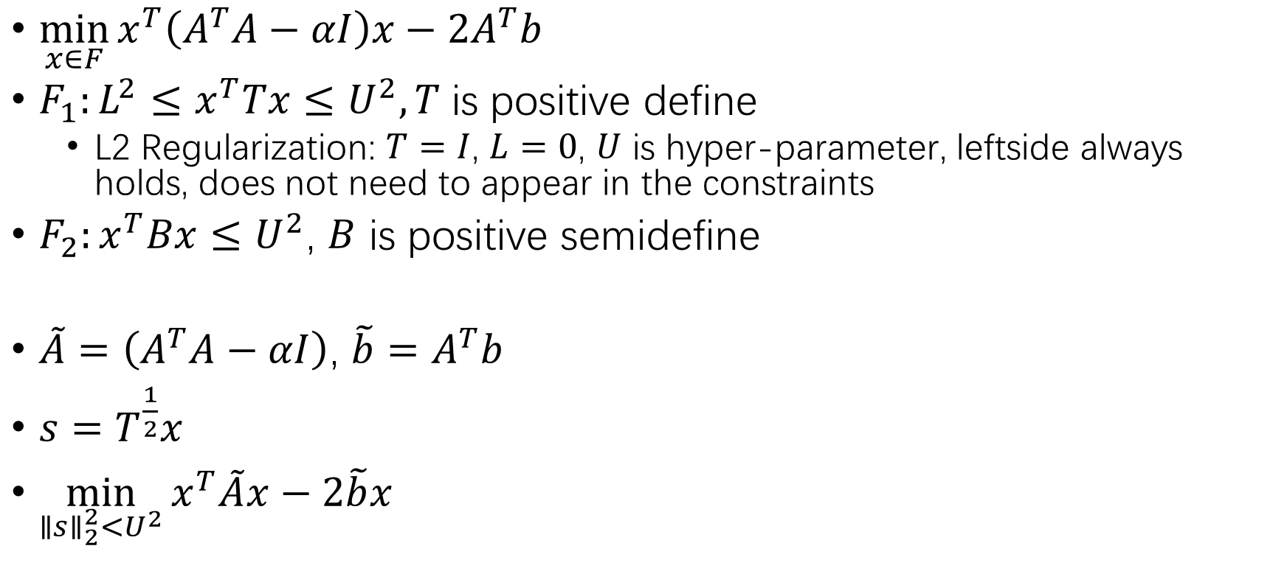
Regularization
$\min_{x∈F}{x^{T}\left(A^{T}A−αI\right)x−2A^{T}b }$
$F_{1}:L^{2}≤x^{T}Tx≤U^{2}, T$ is positive define
L2 Regularization: $T=I$, $L=0$, $U$ is hyper-parameter, leftside always holds, does not need to appear in the constraints
$F_{2}:x^{T}Bx≤U^{2}$, $B$ is positive semidefine
$\tilde{A}=\left(A^{T}A−αI\right)$, $\tilde{b}=A^{T}b$
$s=T^{\frac{1}{2}}x$
$\min_{∥s∥_{2}^{2}<U^{2}}{x^{T}\tilde{A}x−2\tilde{b}x}$

Slide 9
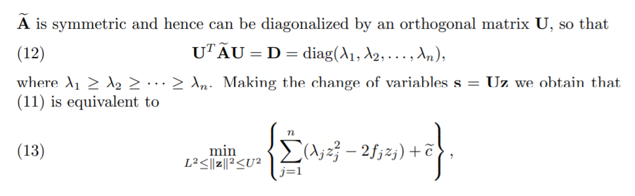

Regularization
$\min_{∥s∥_{2}^{2}<U^{2}}{x^{T}\tilde{A}x−2\tilde{b}x}$
$s=Uz$, $f=Ub$

Slide 10
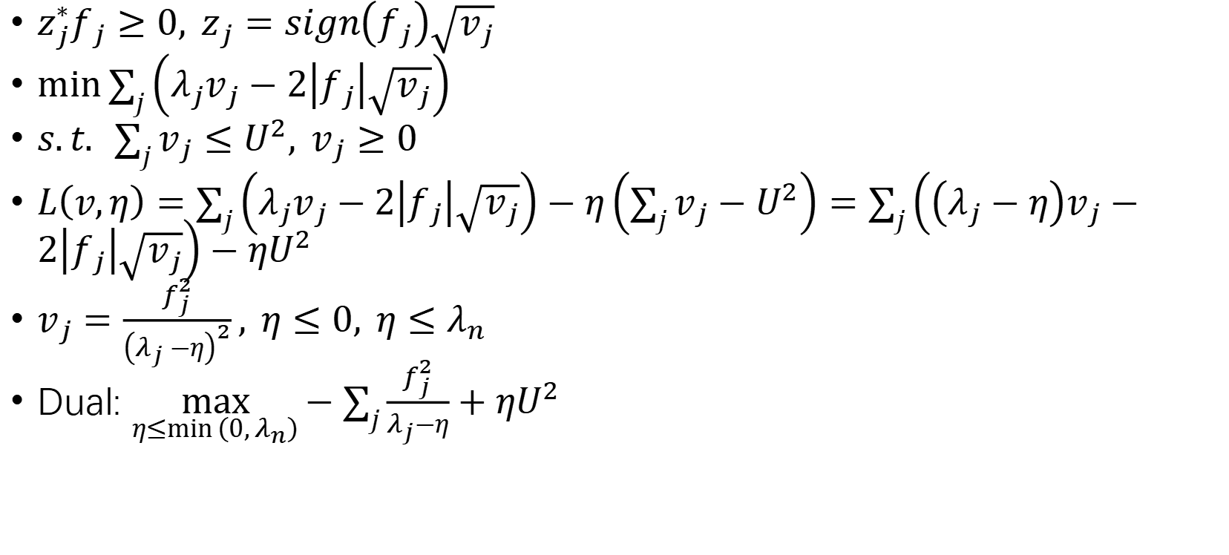
Regularization
$z_{j}^{∗}f_{j}≥0, z_{j}=sign\left(f_{j}\right)\sqrt{v_{j}}$
$\min{\sum_{j}{\left(λ_{j}v_{j}−2\left|f_{j}\right|\sqrt{v_{j}}\right)}}$
$s.t. \sum_{j}{v_{j}}≤U^{2}, v_{j}≥0$
$L\left(v,η\right)=\sum_{j}{\left(λ_{j}v_{j}−2\left|f_{j}\right|\sqrt{v_{j}}\right)}−η\left(\sum_{j}{v_{j}}−U^{2}\right)=\sum_{j}{\left(\left(λ_{j}−η\right)v_{j}−2\left|f_{j}\right|\sqrt{v_{j}}\right)}−ηU^{2}$
$v_{j}=\frac{f_{j}^{2}}{{\left(λ_{j}−η\right)}^{2}}, η≤0, η≤λ_{n}$
Dual: $\max_{η≤\min\left(0,λ_{n}\right)}{−\sum_{j}{\frac{f_{j}^{2}}{λ_{j}−η}}+ηU^{2}}$

Slide 11
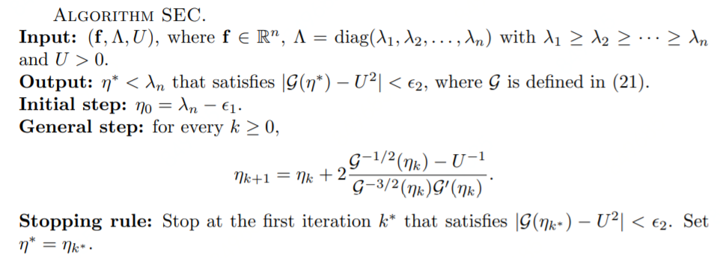




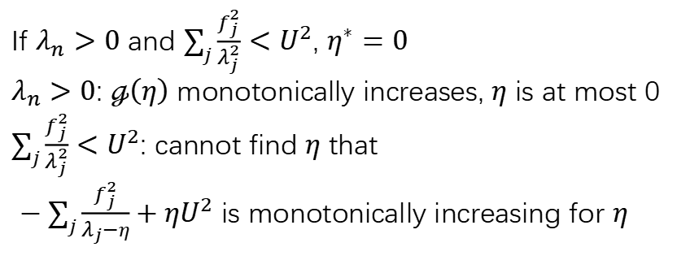
Algorithm
If $λ_{n}>0$ and $\sum_{j}{\frac{f_{j}^{2}}{λ_{j}^{2}}}<U^{2}$, $η^{∗}=0$
$λ_{n}>0$: $ℊ\left(η\right)$ monotonically increases, $η$ is at most 0
$\sum_{j}{\frac{f_{j}^{2}}{λ_{j}^{2}}}<U^{2}$: cannot find $η$ that
$−\sum_{j}{\frac{f_{j}^{2}}{λ_{j}−η}}+ηU^{2}$ is monotonically increasing for $η$

Slide 12



Procedure
Find upper (any feasible value, or achieved using LS) and lower (0) bounds
Search using CV
$$\min_{x∈F}{x^{T}\left(A^{T}A−αI\right)x−2A^{T}b }$$
$$\min{\sum_{j}{\left(λ_{j}v_{j}−2\left|f_{j}\right|\sqrt{v_{j}}\right)}}s.t. \sum_{j}{v_{j}}≤U^{2}, v_{j}≥0$$
$v_{j}=\frac{f_{j}^{2}}{{\left(λ_{j}−η\right)}^{2}}$, $z_{j}=sign\left(f_{j}\right)\sqrt{v_{j}}$, $x=L^{−1}Uz$
Binary Search $α$

